Slide 1
Positive parental involvement
Notes:
This template presentation is designed to be amended, expanded, re-ordered or branded as required by the organisation. We have included suggestions for exercises, group discussions, or more a few specific examples – this can be amended depending on time requirements.
The key focus of this presentation is to emphasise how important parents and carers are within their child’s sporting lives and why positive involvement is so valuable. If parents/carers feel valued they are far more likely to continue to engage

Slide 2
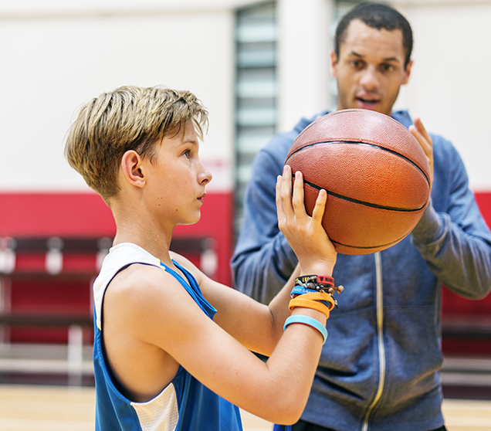
Aims
Today we will:
look at the benefits of being involved in your child’s sport
find out how you can be positively involved in your child’s sport
share strategies to help you support your child
help you to understand your key role in keeping all children safe in sport.
Notes:
Overall aims may be amended as appropriate to the type of event, sports context and audience
However, whatever changes you make to the aims, please remember that the focus is on highlighting the positive influence of parents/carers and providing strategies to help parents/carers optimise or enhance their support.
The term ‘Parent’ is used to mean parents or carers of children or young people participating in sport.

Slide 3
Parents and carers play a vital role in encouraging, enabling, and supporting children’s safe participation in their chosen sport – at every level and in every sport. Youth sport wouldn’t exist without you!
Notes:
Highlight why you are having this presentation – the reason is because children would not be able to participate in sport without parents and carers. Parent/carers take on all the roles and responsibilities relating to providing opportunities, emotionally supporting children, communicating with coaches etc.
Clubs wouldn’t exist, coaches wouldn’t be in positions, and children wouldn’t be playing if parents and carers did not make the time, commit the money or take an interest in their child’s sport.
Before moving onto the next slide it might also be useful to highlight that the focus of this presentation is on supporting parents and carers, not upon highlighting issues or telling them how to parent.
The aim really is to help them fulfil their roles as well as they possibly can.

Slide 4


Notes:
Take this opportunity to feedback your gratitude to parents and carers – you can tailor this to the specific activities they take on within your club.
By highlighting that you appreciate their involvement you are encouraging an open and communicative environment, where parents and carers feel they are valued and able to engage with you. This will help both you and parents/carers to provide the very best support to children.

Slide 5
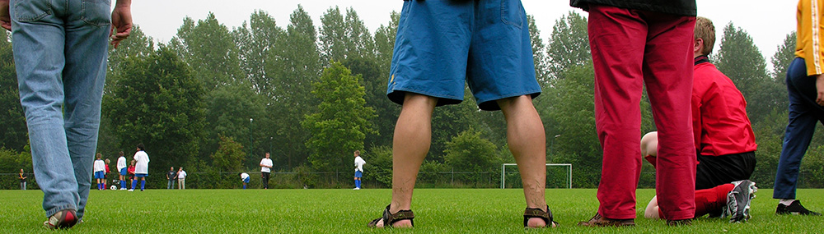
Why we need parents support

Slide 6
Why is your involvement so important?
Your positive involvement means that:
children are more likely to have chances to try new things, stay in sport, and reach their potential
they’ll have more fun if they can share it with you
children have someone to talk to when they face challenges or disappointments
you can help your child to have a safe experience.
Notes:
Explain to parents and carers that you want their involvement in your club or organisation and help them to understand all the positive things that happen when they are involved positively. First focus on what children gain from being involved – on the next slide we’ll focus more on you as a club.
You can now have an open discussion or split into groups around the various other benefits. Ask parents and carers to feedback. There are huge numbers, including:
Increased effort
Better behaviour from children
Improved relationships between parents and children
Increased learning of life skills
Better communication with teammates and coaches
We have to have parents and carers involved for all these benefits to exist – but we need them involved in positive and supportive ways. The aim of this presentation is to help them achieve this.

Slide 7
It’s also important for us!
Because…
you’re the best person to help us to understand your child better
you can help to reinforce the lessons and ideas that we are teaching your children at home
you can raise concerns early and calmly so that we can act on them
we can all work together to create a safe place for children to enjoy sport.
Notes:
Now it’s about how parental and carer involvement helps the club. Tailor this to the specific benefits that your coaches/club get from having parents/carers involved and engaging with them in a positive and supportive manner.
The key here is that if parents and carers are involved and there is open and honest communication between everyone involved in the club, this can be really useful.
Parents and carers want to be involved in their child’s sport (in most cases) and they want to know that this is welcomed and that it will be beneficial not a hindrance.

Slide 8
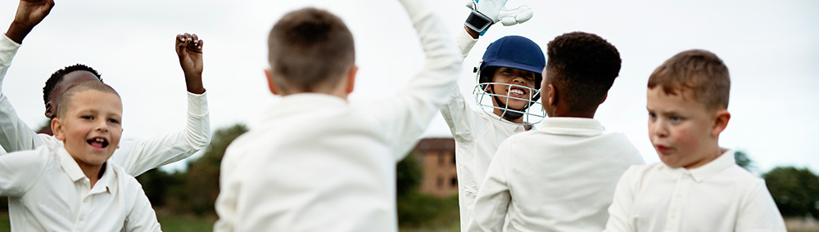
Being a great sport parent

Slide 9

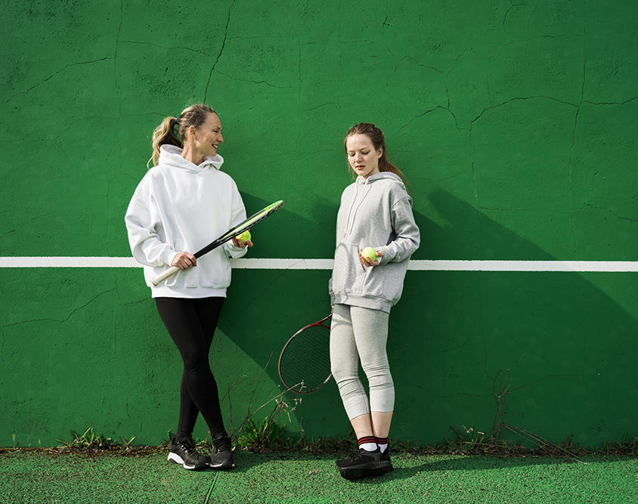
How can parents and carers get involved?
You can be someone who:
provides and protects
speaks up for your child
models good sportsmanship
Notes:
Ask for a parent or carer to share a few examples of some of the things they do to support their child’s involvement in sport. This will encourage parents/carers to share ideas and methods in terms of supporting their child.
Explain that many of the suggestions and roles can be grouped into three roles: the provider/protector, the interpreter, and the role model – each key role will be explored in the next slides.

Slide 10
Being a great provider
Here’s some ways in which you can be involved as a provider for your child…
encourage them to be involved in the first place!
pay any fees for training and tournaments or away trips
buy the right kit/equipment (check with the club if you’re not sure what they need)
wash kits
get trained up as a first aider for the club if you can
provide transport to sessions, training, matches etc.
Notes:
Encourage parents and carers to think about how they provide for their children practically. Selecting a safe well-run activity/club is one of the first things parents should do.
We often only focus on this first category, but there are two other really important role that parents and carers play. Helping parents/carers understand their whole influence in the other two can be a good reflection for them.

Slide 11
Being a great protector
You can make sure your child is safe and looked after by checking the club has basic safeguarding practices in place such as:
a safeguarding policy
safeguarding training and vetting for coaches/ volunteers
codes of conduct for staff, children and parents
a named and contactable club welfare officer
information on how to raise a concern.
Notes:
Parents can find out more about what should be in place in a sports club or how to raise a concern at https://thecpsu.org.uk/parents

Slide 12

Speaking Out in Sport
Notes:
You could play this short animation for parents on speaking out in sport. The animation covers:
How to spot the signs of abuse and poor practice in sport
What should be in place at a club
Who to turn to for help.

Slide 13
Being a voice for your child
It’s great to offer feedback but sometimes it’s more important to listen to your child’s views.
offer encouragement and support - you can help your child make sense of their experience
you can help children learn to cope with winning and losing - learn what is seen as important (like effort or fun, improving) and what is less important (like medals or always having to win)
talk to your child about their sport and understand their needs and goals.
Notes:
Parents can be their child’s interpreter through their feedback and engagement
Parents can help advocate for their child’s needs e.g. more water breaks if a child is struggling with the activity, advocating for any additional needs to be supported, spotting injuries and speaking up to officials and coaches
parents/carers help children make sense of their child’s experience in sport.
The way feedback is provided and comments are made is so important here.
With an understanding of the sport, parents can also help translate instructions from coaches or other staff in ways that children can understand
The interpreter is also about listening to the child’s needs and reacting accordingly.

Slide 14
Being a great role model
You can model positive side line behaviour and good sportsmanship to your child by:
being active yourself
being supportive
playing by the rules
engaging positively on the side lines and with other parents and coaches, refs or officials
not always focusing on score or winning
backing refs, coaches or official’s decisions where you can.
Notes:
by being active, loving sport, being supportive, playing by the rules, engaging appropriately on the side lines – parents and carers are teaching children that this is what they should do.
It’s also about being a role model to others in the sporting community.
Highlighting and discussing these three methods of getting involved as a parent/carer allows parents and carers to reflect on their involvement from many perspectives.
You could also use this opportunity to talk about what good side line behaviour looks like in your sport, use some positive examples of cheering positive things or good examples of the kind of language you’ve seen parents use with children, perhaps when things don’t quite go to plan.

Slide 15

But, being involved in the ways children want isn’t always easy. Sport, particularly competitions, can be emotionally charged and can place lots of demands on parents and carers, which can lead to less than optimal involvement. Developing strategies to manage your emotions and reflect on your involvement can help you to optimise your involvement for your child.
The challenges for parents and carers
Dr Camilla Knight, Swansea University
Notes:
The focus now shifts a little away from what parents and carers do to some of the barriers that might prevent optimal involvement. If parents/carers are to be best involved in their child’s sport, we need to understand that it is not always easy for them. Taking some time to think about how they can enhance their involvement and the support and strategies they need to develop can be really important for supporting both the child and the parent/carer in their involvement in sport.

Slide 16
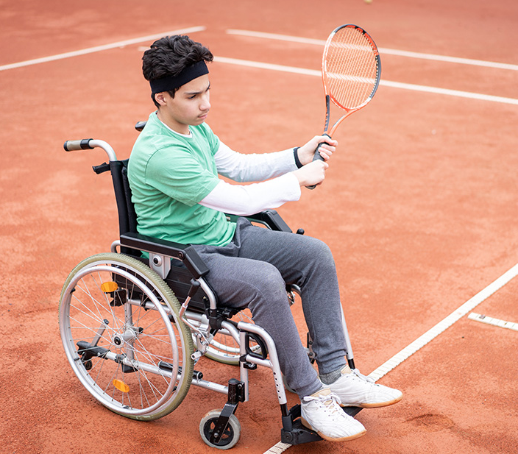
Why can parental and carer involvement be challenging?
For a…
parent/carer
child
club
Notes:
Discuss more about why parental/carer involvement can be challenging for the parent or carer, child, and club. This can be done as a whole group, or in smaller groups, feeding back to each other at the end. Groups give a chance for parents/carers to really be honest and reflect on their experiences, as well as find a shared understanding over some of the challenges.
After feeding back, go on to discuss how some factors – including the challenges discussed - can lead to less than optimal engagement from parents/carers e.g. emotional time for parents/carers and children, being frustrated by apparent lack of knowledge of the coach, behaviour, living life through their child, poor behaviour, adults conflicts over-spilling into the sport.
It’s also good to link back to how strategies for positive involvement not only aim to create a safe and enjoyable environment for the child, but also aim to support parents and carers to be able to effectively get involved and reduce challenges discussed.

Slide 17

What children want from you

Slide 18
What do young people want from their parents and carers?
respect to referees, coaches, and other parents and carers
positive but realistic feedback after competitions
At competitions
feedback on effort and attitude rather than technical or tactical aspects
practical advice and support, such as food, or help with kit
encouragement for all the team whilst keeping your emotions in check
Knight et al., 2010; 2011; Knight & Holt, 2014 ; Furusa, Knight & Hill, 2018
links at end of presentation
Notes:
Now we have more of an understanding of how parents/carers get involved and some of the challenges faced, let’s look at how young people want their parents/carers to be involved. At the forefront of successful involvement in sport is an understanding of what young people want themselves.
Lots of research has been carried out with children focusing on what they want from their parents and carers sport, and generally, it’s pretty clear that children want their caregivers to be supportive but not pressurising. However, it’s important to reiterate that every child will have different needs.
These two slides explore some examples (from research) of how young people want their parents/carers to be involved, but here is also an opportunity to bring in quotes or feedback from your specific club.

Slide 19
What do young people want from their parents and carers?
understand the role of sport in their life
learn about their sport from other coaches, parents/carers, and online
At home and training
remembering to give them time just to be a child – it’s not all about sport!
to listen and talk about sport on their terms, in their own time
to talk to them about what they want and need from you and sport
Knight et al., 2010; 2011; Knight & Holt, 2014 ; Furusa, Knight & Hill, 2018
links at end of presentation
Notes:
Use these two slides as a basis to discuss the differences that can occur between what children want and what parents/carers want for their children in sport

Slide 20

We just want to have fun, learn new skills and make new friends...
Notes:
Remind the parents/carers that talking to their child, learning exactly what their child wants from them, and trying to focus on why their child is involved in sport is the very best way you can support involvement.

Slide 21

Making the most of getting involved

Slide 22
Share and communicate with your child about their goals
talk to your child about their goals and how they’d like you to be involved. Think about:
What does your child want to get from sport?
What are they striving for?
How do they want you to help at competitions, training, and home?
customise your involvement to what your child needs
recognise that goals might change over time, so regularly check in to make sure you can adjust your involvement if necessary.
Notes:
So now, parents and carers should have more of an understanding as to the various roles they might play, the challenges of involvement, as well as what children may want from parental/carer involvement. Now let’s look at HOW we can get to ensure involvement is as positive and optimise to the child as possible.
Researchers have identified four key strategies. The first is about sharing and communicating goals between the parent/carer and child.
Conflict can arise if parents/carers and children have different goals for sport. For instance, if the child wants to have fun in sport but the parent/carer wants them to become a professional athlete, this may cause challenges and the child might feel unsupported. For successful involvement, it’s crucial for parents and carers to regularly talk with their child, get an understanding of their child’s goals, and tailor involvement to help the child meet their own goals.
You could ask the parents/carer to reflect- or discuss - on whether they really understand their child’s needs and experiences, or if they are overly focused on what they themselves want their child to achieve. It’s also good to get parents and carers to spend time practising having that conversation they might have at home with their child to get a better understanding of their needs. What kind of questions would they ask? Brainstorm in small groups or as a large group.

Slide 23
Let them know it’s safe to share things with you
learn about your child’s sport so you can understand more about your child’s experience
develop a good relationship and regular communication with your child’s coach to help understand your child’s sport and work together
keep sport in perspective – it’s likely to be an important part of your child’s life, but it is only one part
develop a support network with other parents or carers, coaches and loved ones to help handle the practical and emotional elements involved in having a child within sport.
Notes:
The second strategy is about building an emotional climate where parents can consistently display an understanding of their child and the role sport plays in their life. It’s also about building an understanding and supportive community, where both parents/carers and children feel supported and able to enjoy involvement in sport.

Slide 24
Make your approach to supporting your child unique
help your child develop the skills to be able to cope with the ups and downs of sport. Children should be independent thinkers, be accountable for their actions and recognise mistakes
talk to your child about what they want from you before, during, and after competitions, as well as during training. Some may need a pep-talk before the game, whereas others may want to be left alone.
Notes:
The third strategy is about tailoring involvement to the unique needs of each child. Not all children need the same involvement from their parents/carers and what works for one child may not work for another. The specific behaviours a child needs are both person and sport dependent. Parents and carers should focus on displaying behaviours that are most helpful for the child, including empowering the child to learn and grow in their own individual coping skills, rather than doing too much for the child.

Slide 25
Get creative with how you give feedback or support
When: | allow yourself time to cool-down and let your child talk with the team and coach before giving feedback
Where: | most children don’t like getting feedback in front of peers and would prefer a conversation in private
What: | avoid focusing on the outcome of the game and instead focus on what your child can control, such as attitude, skill development and behaviour
How: | try to let your child let you know when they are ready to talk about it.
Notes:
The fourth strategy is about finding ways to effectively communicate feedback with your child. Sport can be an emotional experience for children, parents/carers, and coaches. Feedback greatly influences how a child perceives their ability, enjoys their sport, and feels motivated to continue participating. In such an emotionally charged environment, ensuring well-timed and delivered feedback is crucial. Whilst every child will need different things, the slide above goes into some suggestions for providing effective feedback.
Further things to discuss at each point:
When: Emotions can be high right after a game or event. Ask your child if they feel ready to talk
What: Keep feedback consistent with coach’s message to avoid confusion for the child
How: Encourage them to share their views and ensure feedback is positive and focused on improvement, rather than critique.
Identifying the best way of supporting a child can also involve parents/carers to really learn about and understand their own emotions. Sport can be very emotional for parents/carers too, and it’s good for parents/carers to learn strategies for managing their own concerns, worries, and feelings, to ensure they can be as supportive as possible.
Take some time to have a discussion about the various strategies they use to help them cope with their emotions and reactions whilst being involved in their child’s sport. Optional exercise: ask parents/carers to break into groups to discuss the various strategies they use to help them cope with their emotions and reactions whilst being involved in their child’s sport. As starting points, they could reflect on:
Any situations that they weren’t expecting – did they react as they’d like?
The parts of their child’s involvement that they find challenging (e.g. injuries or seeing them upset) and explore strategies for coping with emotions around this.

Slide 26
How can we help this happen?
Positive involvement is a two-way street. We as a club have a responsibility to:
have a high level of knowledge and offer regular advice and information around topics within the sport
focus on your child’s abilities and potential and regularly update you
keep children learning and thriving in a safe, secure environment
build supportive, understanding relationships between parents/carers and coaches, including making time to listen to concerns and offer advice
make you feel welcome at every practice and every match
support your child to achieve your joint goals in a positive way
provide clear expectations around everyone’s behaviour.
Notes:
You can amend or add to these points as necessary but make sure parents and carers feel that there is a two-way relationship between you as an organisation and them.
Ask for volunteers to give more examples – there are abundance of other ways that clubs should be supporting positive parental/carer involvement including: developing a clear learning environment, sharing coaching philosophy with parents, keep a high level of sport education including the latest technical, physical, and psychological information, create expectations for how and when parents/carers should expect to hear from you and are able to contact you, provide parents/carers with approved resources to help them become as educated as possible, make time to adequately communicate with parents/carers and avoid rushed conversations

Slide 27

The types of parental and carer involvement we want to have at our club to ensure all children have positive and safe experiences…
Notes:
Use this slide as an opportunity for a final group discussion to set the expectations of each other within this club.
This is your chance to set out what is expected of parents/carers and how they can best help you and also allow them to identify what they are expecting of each other.

Slide 28
When we all want to get involved in a positive way, we will:
See
Avoid
parents/carers helping out the coaches, club, other children, and each other
realistic expectations, with a focus upon each child’s development
a positive approach from everyone involved
supportive and encouraging cheering from the sidelines
knowledge of and following the rules and culture of the sport.
the sport or club getting a bad reputation
coaches or officials being under stress at competitions
A feeling of fear or actual assaults on players and officials
Children, parents/carers, coaches, or officials leaving the sport
An unsafe environment
Notes:
The focus of this final learning slide is on helping parents/carers to understand that there are benefits to all when we are involved in the best ways – it prevents negative outcomes that are increasingly seen in youth sport and instead creates an environment of learning, development and positive engagement for all.
There are many consequences that will be seen/avoided. These are just some examples – you can suggest further examples from your own club, as well as ask parents/carers to volunteer suggestions.

Slide 29
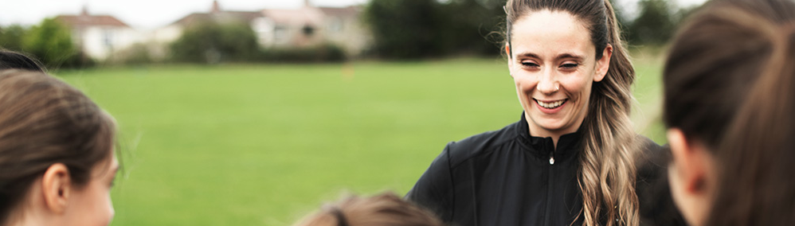
Helping us to make sure all children are safe

Slide 30
How you can help us to keep children safe in our club
If you see something that concerns you or your child talks to you about something they’re worried about please contact us straight away.
Insert a picture of your welfare officer or club logo here
Our club welfare officer is:
Name: XXXXXX
Tel: XXXXXXX
Email: XXXXX
Notes:
Include relevant contact details (telephone, email, website) and go over the details of your reporting procedures if there are any parents/carers who are engaged in manners that you do not want to see.
Explain the process of recording and responding to incidents of poor behaviour. Do you have a strike system? Or do you have a zero tolerance policy?
Make parents and carers aware of the types of sanctions that could be imposed on them or their child if their own manners and attitudes becomes a problem.
If you can, use an example of how a case of poor manners has been handled in your sport and the types of sanctions you’d like to

Slide 31
Remember: We can make sport fun and safe together!
For more information on how you can be a great sports parent/carer, visit thecpsu.org.uk/parents
Our campaign, Keeping Your Child Safe in Sport, also offers resources, advice, and guidance for positive parental involvement. Find out the latest information by visiting thecpsu.org.uk/parents/keeping-your-child-safe-in-sport-campaign
Notes:
Signpost parents to the CPSU website or your own parents information for further guidance and support.
You might want to use this time to hand out resources or tell parents about specific ways in which to contact you for support.

Slide 32
Useful resources for parents
The NSPCC nspcc.org.uk/keeping-children-safe
The NSPCC Child Protection in Sport Unit (CPSU) thecpsu.org.uk/parents
Childline childline.org.uk
FREE eLearning for sports parents thecpsu.org.uk/parents/keeping-your-child-safe-in-sport-e-learning-course

Slide 33
Thank you for joining us

